Slide 1

Minimum & Maximum mode
By
G HARISH BABU M.TECH, (Ph.D)
Asst Professor
Dept of ECE
CVR COLLEGE OF ENGINEERING

Slide 2
Minimum mode 8086 system
Turns MN/MX pin to logic 1
Control signals are given by microprocessor chip itself.
Single microprocessor with latches, transrecievers, clock generator, memory & IO devices
Latches are used to separate valid address from address/data signals controlled by ALE
Transrecievers are bidirectional buffers ,Also termed as data amplifiers and it is Controlled by DEN or DT/R

Slide 3
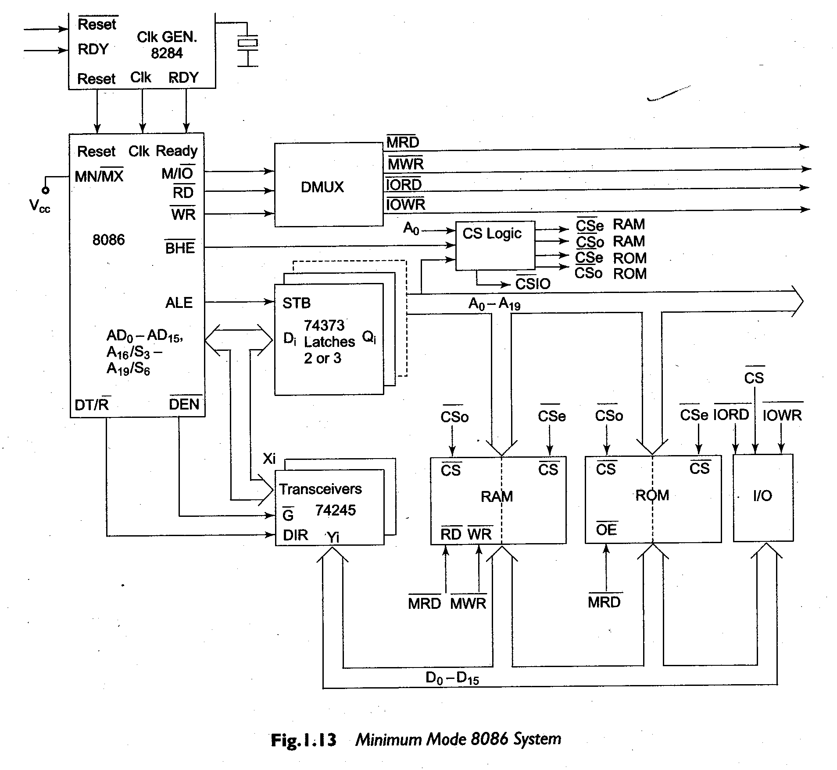

Slide 4
Latches are generally buffered output D-type flip-flops like 74LS373 or 8282.
They are used for separating the valid address from the multiplexed address/data signals and are controlled by the “ALE” signal generated by 8086.
Transreceivers are the bidirectional buffers and some times they are called as data amplifiers.
They are required to separate the valid data from the time multiplexed address/data signals. They are controlled by two signals namely, DEN and DT/R.
The DEN signal indicates that the valid data is available on data bus, while DT/R indicates the direction of data, i.e. from or to the processor.

Slide 5
For interfacing memory module to 8086, it is necessary to have odd and even memory banks.
This is implemented by using 2 EPROM’s and two RAM’s.
Usually EPROMs are used for monitor storage, while RAMs for user program storage.
The system may contain I/O devices for communication with the processor.
Other signals
M/IO | RD | WR | OPEARATION
0 | 0 | 1 | I/O READ
0 | 1 | 0 | I/O WRITE
1 | 0 | 1 | MEMORY READ
1 | 1 | 0 | MEMORY WRITE

Slide 6
The HOLD and HLDA signals are used to interface other bus master like DMA controller.
INTR and INTA are used to extend the interrupt handling capacity of 8086 with help of interrupt controller.

Slide 7
Bus timings for minimum mode
The opcode fetch and read cycles are similar.
Hence the timing diagram can be categorized in two parts
Read cycle and
Write cycle
These are explained in steps

Slide 8
T1
T2
T3
Tw
T4
ALE
BHE
A19-A16
S3-S7
Add/Stat
Add/Data
A15-A0
Bus reserved for data in
D15-D0
RD
DEN
DT/R
READ CYCLE TIMING DIAGRAM

Slide 9
T1
T2
T3
Tw
T4
T1
ALE
BHE
A19-A16
S3-S7
Add/Stat
Add/Data
A15-A0
D15-D0
wr
DEN
DT/R
WRITE CYCLE TIMING DIAGRAM

Slide 10
Hold response sequence
The HOLD pin is checked at leading edge of each clock pulse.
If it is received active by the processor before T4 of the previous cycle or during T1 state of the current cycle, the CPU activates HLDA in the next clock cycle and for succeeding bus cycles, the bus will be given to another requesting master.
The control of the bus is not regained by the processor until the requesting master does not drop the HOLD pin low.
When the request is dropped by the requesting master, the HLDA is dropped by the processor at the trailing edge of the next clock.

Slide 11
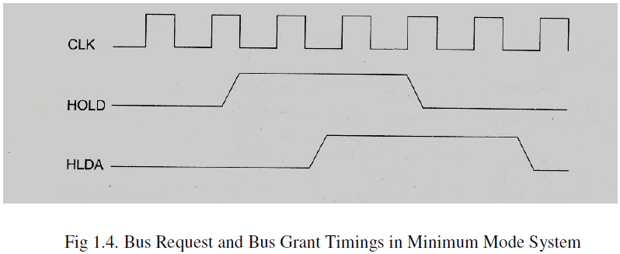

Slide 12
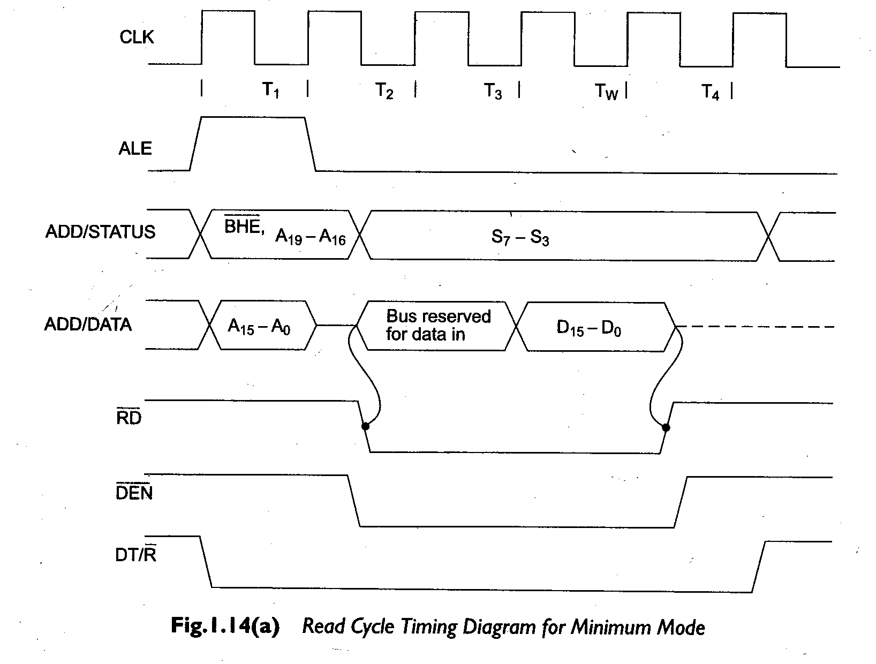

Slide 13
